Slide 1

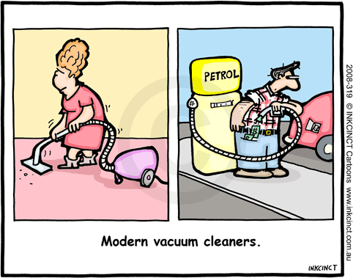
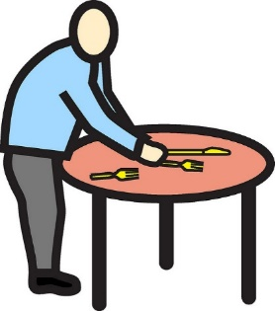
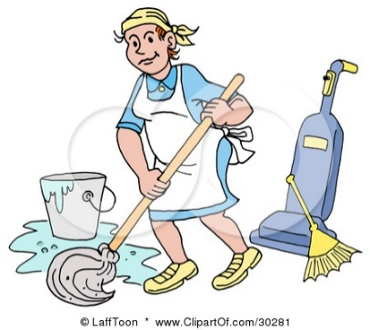
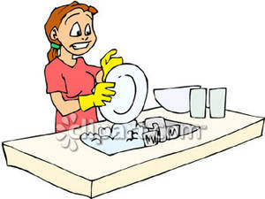
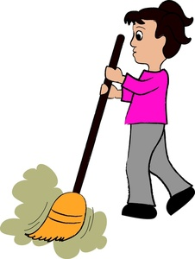
CHORES
Energy for Bulgaria
For the 7th grade
Teacher: Vladimira Teneva

Slide 2
Big Idea: Making surveys and Interpreting graphs and charts
Students spend too much time on their mobile devices and
The result - they become lazy
Do not have basic skills and habits for living.
Rely too much on their parents to have a good environment at home.
TODAY
You are researchers (you want to know more about the number of teenagers who participate in household activities).
Choose a method to find out how often your classmates help their parents at home
What are the most popular / unpopular chores they do.
RESULTS
INFORMATION
CHART
MINI-POSTER
PRESENT
Work in groups of four collaboratively, to design the final vision of the mini-poster.
Each group should choose a speaker to present their results in front of the class within 1 minute.

Slide 3
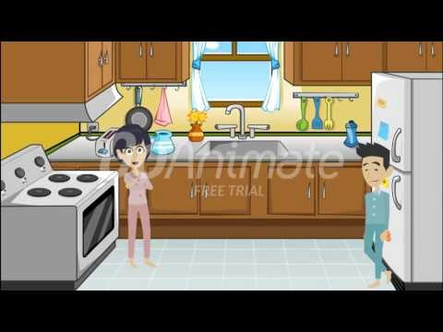
Mr. Joe‘s family houshold chores
Watch the video
Work in groups
On your worksheet stick the picture/s that show what chores each character has to do.

Slide 4
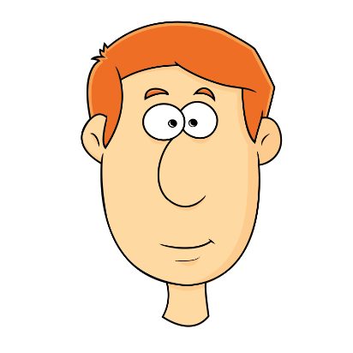

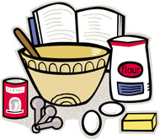

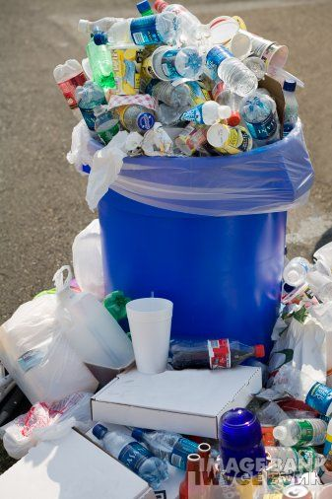

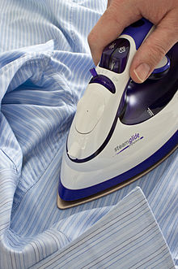
Mr Joe
Mrs Jane
WWW.QUIZLET.COM/VLADIMIRA_TENEVA

Slide 5
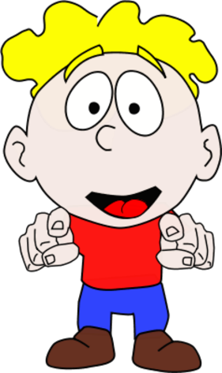
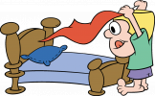
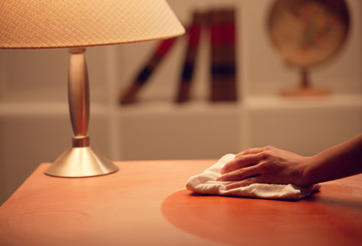
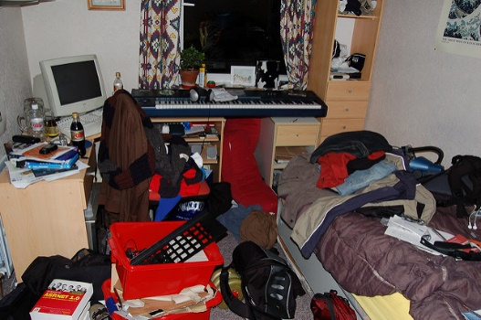
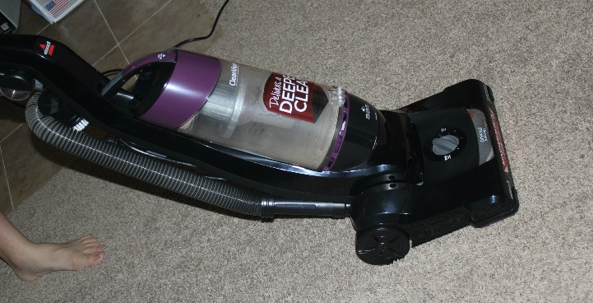
Kevin
WWW.QUIZLET.COM/VLADIMIRA_TENEVA
Has already done
Has to

Slide 6



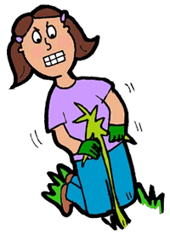
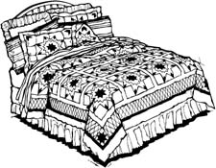
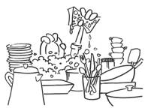
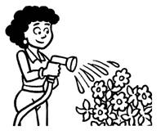

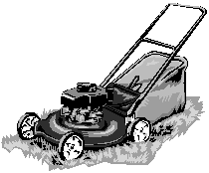
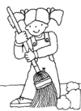
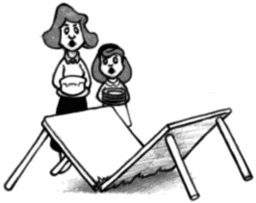
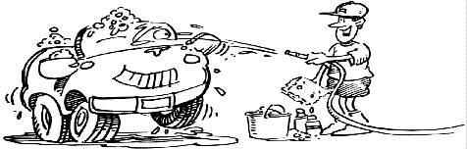
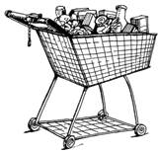
Read the text and underline the household chores
1
Hi my name is Adam. I live with my family in a big house. I have two sisters and one brother. We share many chores with our parents. My brother and I take the garbage out.
Hi my name is Sally. My family is small, my father, my mother, my sister Joanna and Me. We live in a flat in a tall building. I help my family with the chores. I make my own bed.
We also wash our father’s car twice a week. Every Friday, I weed the garden and my brother waters the plants. I also make my bed in the morning. My sister, Emily, sweeps the floor every evening and washes the dishes after dinner. She also helps Mom with shopping every Thursday. My mother cooks for us and washes our clothes. My father fixes anything broken at home.
I set the table for dinner while mom cooks. Every Tuesday my parents go shopping for food and I take care of my sister Joanna and help her with homework. My father fixes things in the house. My mother cooks our meals and sweeps the floor every night. When Mom or Dad is tiered I bring water for them.
Write (A) next to Adam’s chores, (S) next to Sally’s chores, and (A|S) next to chores they share.
Reading

Slide 7
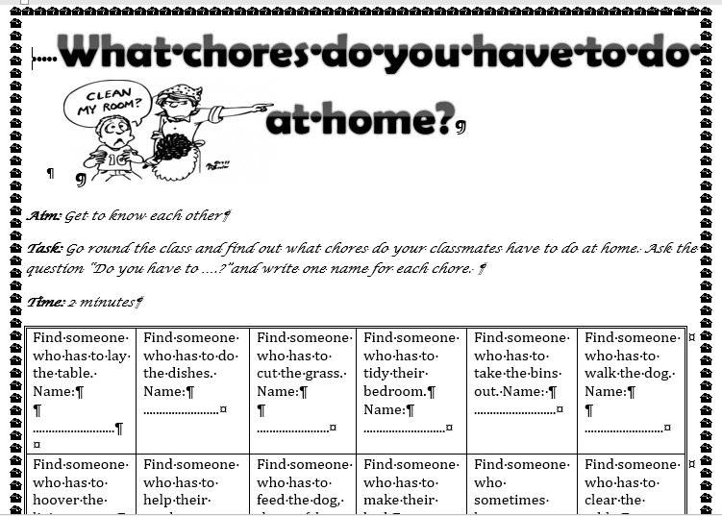

Slide 8
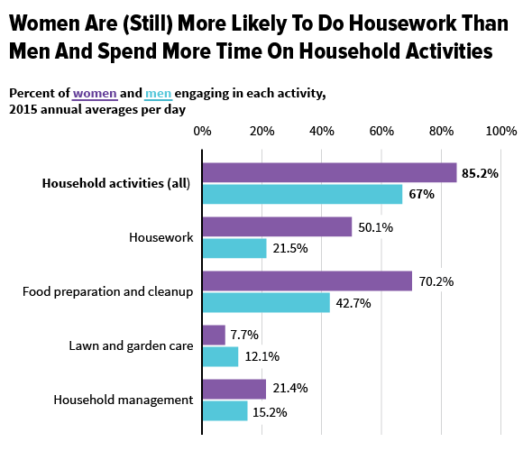
ALL OF …………..
MOST OF ……….
SOME OF…………
A FEW OF ………..
NONE OF …………..

Slide 9
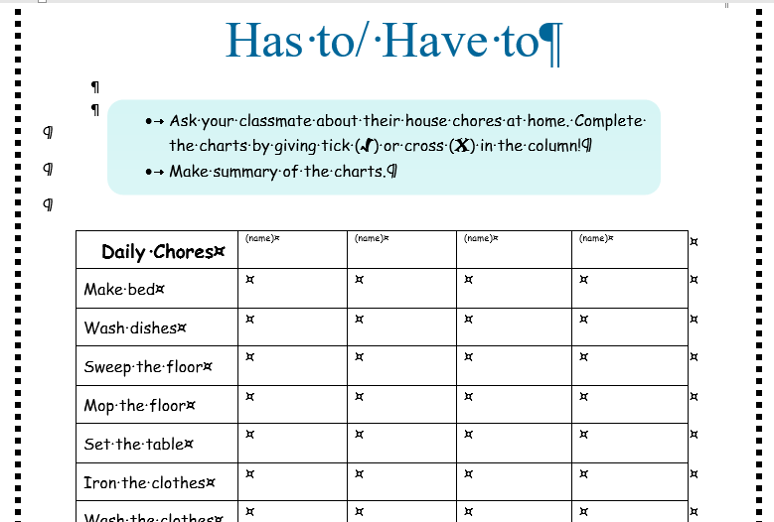
GROUP TASK
Make a survey within the group.
Fill in the information table
Create a chart on the white sheet of paper
Summarize the information in one paragraph
Choose one speaker to present the information.
Pin your mini-poster on the wall
WORK IN GROUP AS A TEAM!!!
USE ENGLISH AS YOUR WORKING LANGUAGE!!!
15 min

Slide 10
What are the most popular chores within boys and girls?
https://goo.gl/forms/VdgrvS8RPIzy0ecv1

